Slide 1
Session 5 – Hive

Slide 2
Pre - requisites
Complete Unit 5.0
Faculty Video Lecture
Self Assessment Quiz Complete
Problem Solving Complete

Slide 3
Session Contents
Queries on Unit 5.0
How Hive came into picture
Definition of Hive
Hive Features
Pig Versus Hive
RDBMS Versus Hive
Hive Architecture
Hive Data Model
Hive Hands On

Slide 4
How Hive came into picture
It all started at Facebook
Prior to Hive, the data at Facebook was collected using nightly cron jobs and hand coded python
This set-up soon became infeasible as the data grew from GBs to TB in around year 2007.
Their data volume increased to :-
About a billion users
Generating close to 500 TB of data per day
Firing 70,000 queries per day
And uploading 300 million photos per day
They realized RDBMS is infeasible for them as the data was mainly unstructured
Map Reduce was also not working out for them as it was hard to program with it associated over head of development cycle.
The fleet of programmers knew SQL all too well
Therefore Hive was conceived at Facebook

Slide 5


So what is Hive ?
Hive is a Hadoop Data Warehousing package built on top of Hadoop Infrastructure.
It comprises of a Query Language similar to SQL called HiveQL
Interface looks similar to MySQL but it is Hadoop behind the scenes.
It was developed by Facebook and donated to Apache Community.
Facebook is the biggest user of Hive.

Slide 6
Hive Features
A higher level of abstraction, just like PIG but more SQLish
It has a flexible schema
Partitioning & Bucketing
Connectors to Traditional Systems like RDMS
Easy plug in of custom map reduce code for additional flexibility

Slide 7
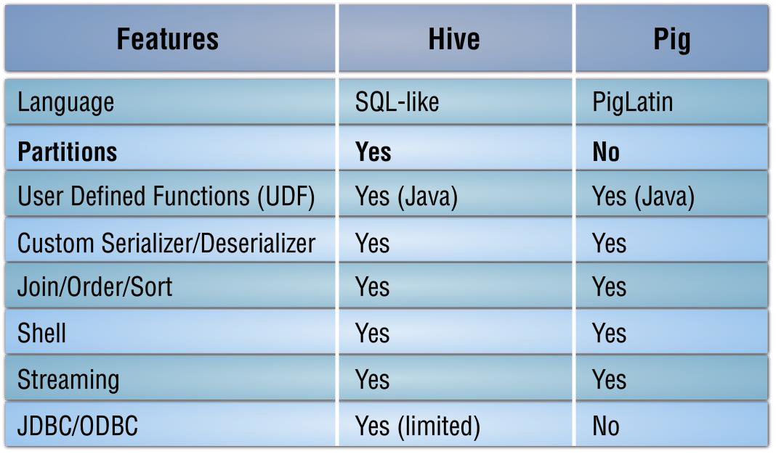
Pig Versus Hive

Slide 8
RDBMS Versus Hive
RDBMS is Schema on WRITE. Hive, just like raw Hadoop, is a schema on READ.
Hadoop, and therefore Hive writes, are very fast due to this.
Initial versions of Hive did not have support for Updates, Transactions and Indexes. This use to add to the speed of data read and writes. Support started from version 0.7 onwards.

Slide 9
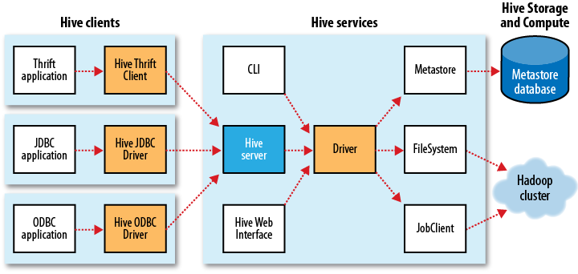
Hive Architecture

Slide 10
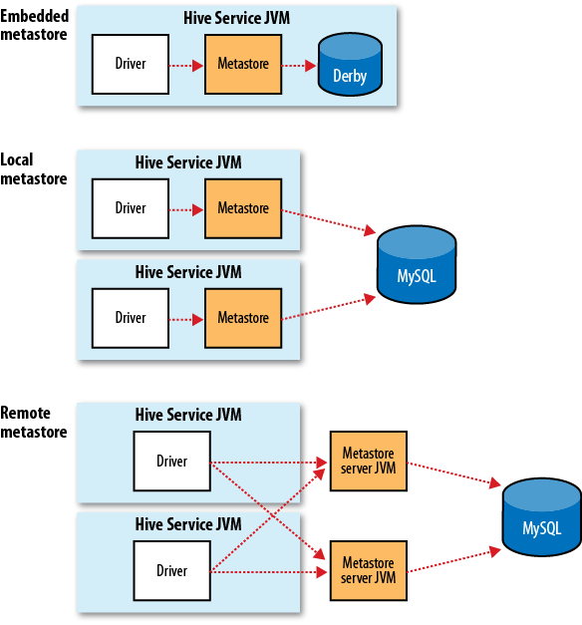
Hive Architecture (Metastore)

Slide 11
Hive Data Model
Type System is similar to java, comprising of the following primitive types
Integer
Floating Point
Boolean
String
Hive also comprises of certain complex types built on the above primitive types as follows :
Structs
Collection of primitives
E.g. foobar{a , b}
Can be accessed via dot notation e.g. foobar.a
Maps
Key Value Tuples
Can be accessed [‘ ’] notation
Arrays
Indexed list
Can be accessed via [n] notation

Slide 12
Hive Hands On
Examples on Cloudera VM

Slide 13

Queries on Unit 3.0

